Slide 1
Theory, Applications, and Tools for Multiscale Kinetic Modeling: Parameterizing Large Models
D. Vlachos and G. R. Wittreich

Slide 2
Modeling Reactions of Large Molecules is Challenging
Combinatorial explosion in number of calculations for first-principles (DFT) calculations
Semi-empirical methods can potentially parametrize relevant species and reactions instantaneously
Major advances in systematic development of semi-empirical methods and understanding of errors
Increasing Computational Time
Sugars
Notes:
Group additivity, first proposed by Benson on the 60’s for gas molecules and later extended to surface molecules, uses groups as a descriptor for molecules.

Slide 3
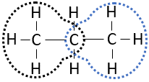
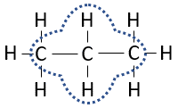
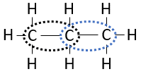
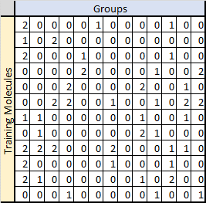


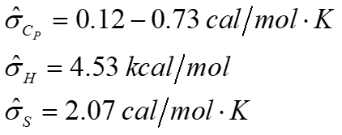
Method: Group Additivity^{1,2}
Propane (C_{P}, H, S) =
2 x C(C)(H)₃ + 1 x C(C)₂(H) + 2 x CC
³
¹ Benson, S. W. et al. (1969), Chemical Reviews
² Kua, J. and Goddard, W. A. (1998), J. Phys. Chem. B
³ https://github.com/VlachosGroup/PythonGroupAdditivity
Gu et al. (2018), Reaction Chemistry & Engineering.
Notes:
Group additivity, first proposed by Benson on the 60’s for gas molecules and later extended to surface molecules, uses groups as a descriptor for molecules.

Slide 4
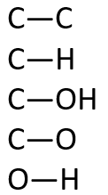
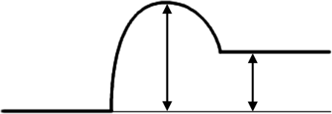
Brønsted-Evans-Polanyi (BEP) Relationships¹
BEP relationships can be used as they enable the prediction of reaction barriers from the heat of reactions for an entire homologous series of reactions
BEPs for common homologous series are available
E_{TS}
Unique!
Not unique!
E_{FS}
E_{A}
E_{IS}
ΔH
[1] Sutton and Vlachos, ACS Catal., 2, 1624 (2012)
Notes:
Group additivity, first proposed by Benson on the 60’s for gas molecules and later extended to surface molecules, uses groups as a descriptor for molecules.

Slide 5

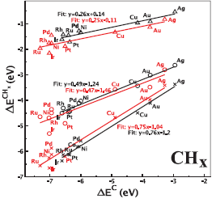
Linear Scaling Relationships (LSRs) for Metal Cats
Simple/Small Molecules:
CHx, NHx, OHx, SHx,…
They work well when AHx binds on catalysts with the same binding mode, e.g., bridge binding
Impact: By computing Q_{A} on a new catalyst, e.g., bimetallic, you can compute Q_{AHx}, so one saves some comps
Polyatomic/Multidentate Adsorption: Extended LSR
^{1,2} Jones, G. et al. (2008) ‘Using scaling relations to understand trends in the catalytic activity of transition metals’, Journal of Physics Condensed Matter Abild-Pedersen et al. PRL 99, (2007)
Notes:
Group additivity, first proposed by Benson on the 60’s for gas molecules and later extended to surface molecules, uses groups as a descriptor for molecules.

Slide 6
Summary of Semi-empirical Methods
Group additivity estimates species thermochemistry for large molecules and mechanisms
Once the groups have been identified via graph theory and the values estimated, these can be used for any mechanism on the same catalyst
Reaction thermochemistry is estimated from species thermochemistry
Extended linear scaling relations can be used to estimate species thermochemistry on a new catalyst from a reference catalyst
BEPs or transition state scalings can be used to estimate reaction barriers from thermochemistry
BEP is applied to the entire homologous series; a few DFT data to estimate and information is then transferable to all reactions of the same family
Tacitly assumed that the BEP holds among catalysts for the same chemistry
These relations are linear; machine learning can be used to improve accuracy, identify descriptors, e.g., groups in GA, and capture nonlinear effects

